Slide 1
CCS3104
ADVANCED PROGRAMMING Chapter 3 Advanced UI Controls and
Multimedia

Slide 2
JavaFX UI Controls, Video and Audio

Slide 3
Motivations
A graphical user interface (GUI) makes a system user-friendly and easy to use. Creating a GUI requires creativity and knowledge of how GUI components work. Since the GUI components in Java are very flexible and versatile, you can create a wide assortment of useful user interfaces.
Previous chapters briefly introduced several GUI components. This chapter introduces the frequently used GUI components in detail.

Slide 4
Objectives
To create graphical user interfaces with various user-interface controls (§§16.2–16.11).
To create a label with text and graphic using the Label class and explore properties in the abstract Labeled class (§16.2).
To create a button with text and graphic using the Button class and set a handler using the setOnAction method in the abstract ButtonBase class (§16.3).
To create a check box using the CheckBox class (§16.4).
To create a radio button using the RadioButton class and group radio buttons using a ToggleGroup (§16.5).
To enter data using the TextField class and password using the PasswordField class (§16.6).
To enter data in multiple lines using the TextArea class (§16.7).
To select a single item using ComboBox (§16.8).
To select a single or multiple items using ListView (§16.9).
To select a range of values using ScrollBar (§16.10).
To select a range of values using Slider and explore differences between ScrollBar and Slider (§16.11).
To develop a tic-tac-toe game (§16.12).
To view and play video and audio using the Media, MediaPlayer, and MediaView (§16.13).
To develop a case study for showing the national flag and play anthem (§16.14).

Slide 5
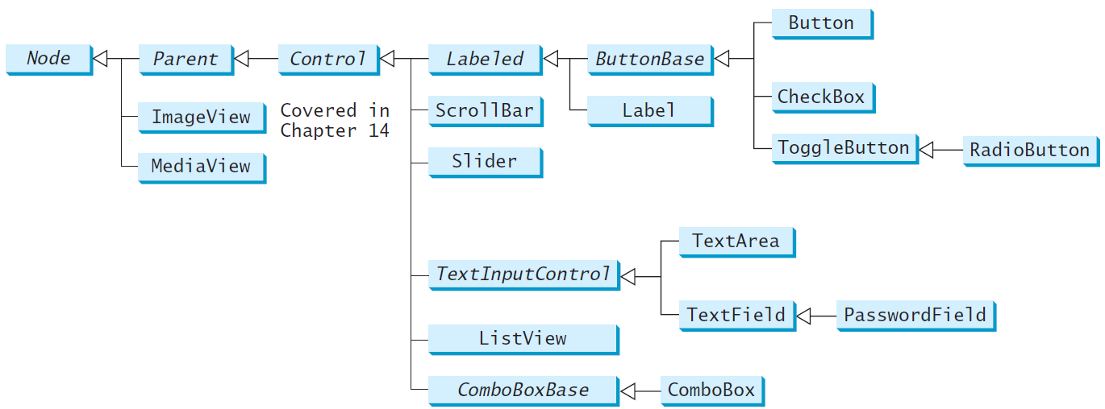
Frequently Used UI Controls
Throughout this book, the prefixes lbl, bt, chk, rb, tf, pf, ta, cbo, lv, scb, sld, and mp are used to name reference variables for Label, Button, CheckBox, RadioButton, TextField, PasswordField, TextArea, ComboBox, ListView, ScrollBar, Slider, and MediaPlayer.

Slide 6
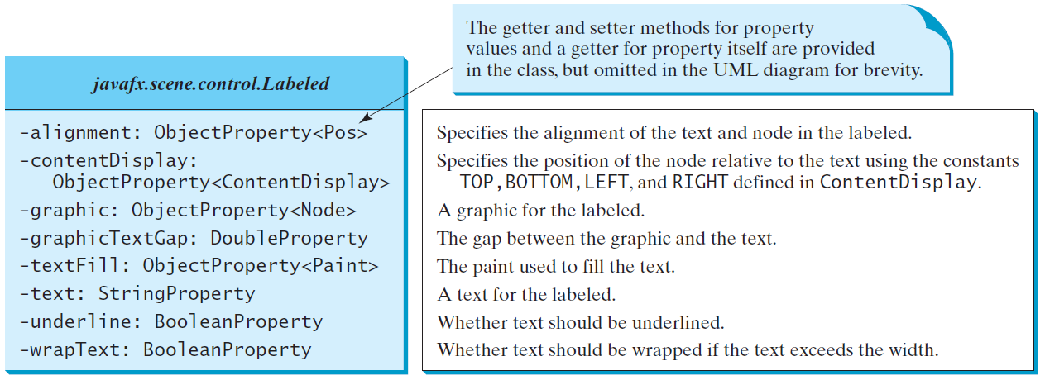
Labeled
A label is a display area for a short text, a node, or both. It is often used to label other controls (usually text fields). Labels and buttons share many common properties. These common properties are defined in the Labeled class.

Slide 7
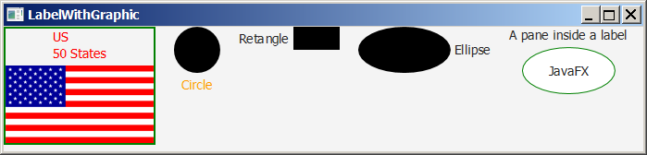
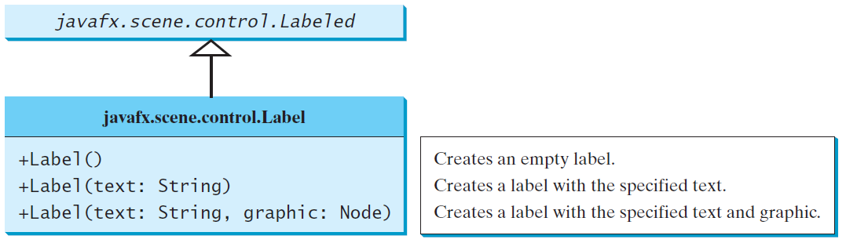
Label
The Label class defines labels.
LabelWithGraphic
Run

Slide 8
import javafx.application.Application;
import javafx.stage.Stage;
import javafx.scene.Scene;
import javafx.scene.control.ContentDisplay;
import javafx.scene.control.Label;
import javafx.scene.image.Image;
import javafx.scene.image.ImageView;
import javafx.scene.layout.HBox;
import javafx.scene.layout.StackPane;
import javafx.scene.paint.Color;
import javafx.scene.shape.Circle;
import javafx.scene.shape.Rectangle;
import javafx.scene.shape.Ellipse;
public class LabelWithGraphic extends Application {
@Override // Override the start method in the Application class
public void start(Stage primaryStage) {
ImageView us = new ImageView(new Image("image/us.gif"));
Label lb1 = new Label("US\n50 States", us);
lb1.setStyle("-fx-border-color: green; -fx-border-width: 2");
lb1.setContentDisplay(ContentDisplay.BOTTOM);
lb1.setTextFill(Color.RED);
Label lb2 = new Label("Circle", new Circle(50, 50, 25));
lb2.setContentDisplay(ContentDisplay.TOP);
lb2.setTextFill(Color.ORANGE);
Label lb3 = new Label("Retangle", new Rectangle(10, 10, 50, 25));
lb3.setContentDisplay(ContentDisplay.RIGHT);
Label lb4 = new Label("Ellipse", new Ellipse(50, 50, 50, 25));
lb4.setContentDisplay(ContentDisplay.LEFT);
Ellipse ellipse = new Ellipse(50, 50, 50, 25);
ellipse.setStroke(Color.GREEN);
ellipse.setFill(Color.WHITE);
StackPane stackPane = new StackPane();
stackPane.getChildren().addAll(ellipse, new Label("JavaFX"));
Label lb5 = new Label("A pane inside a label", stackPane);
lb5.setContentDisplay(ContentDisplay.BOTTOM);
HBox pane = new HBox(20);
pane.getChildren().addAll(lb1, lb2, lb3, lb4, lb5);
// Create a scene and place it in the stage
Scene scene = new Scene(pane, 450, 150);
primaryStage.setTitle("LabelWithGraphic"); // Set the stage title
primaryStage.setScene(scene); // Place the scene in the stage
primaryStage.show(); // Display the stage
}
/**
* The main method is only needed for the IDE with limited
* JavaFX support. Not needed for running from the command line.
*/
public static void main(String[] args) {
launch(args);
}
}

Slide 9
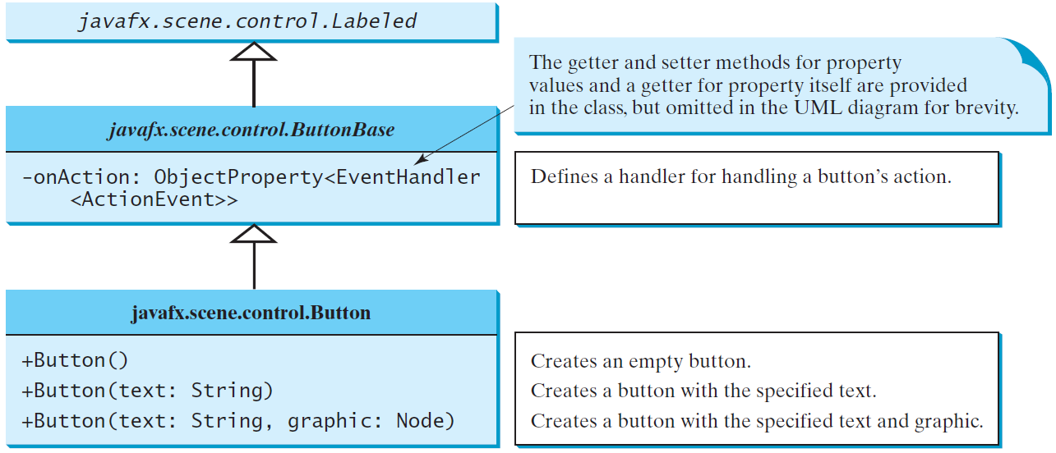
ButtonBase and Button
A button is a control that triggers an action event when clicked. JavaFX provides regular buttons, toggle buttons, check box buttons, and radio buttons. The common features of these buttons are defined in ButtonBase and Labeled classes.

Slide 10
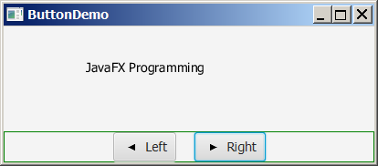
Button Example
ButtonDemo
Run

Slide 11
import javafx.application.Application;
import javafx.stage.Stage;
import javafx.geometry.Pos;
import javafx.scene.Scene;
import javafx.scene.control.Button;
import javafx.scene.image.ImageView;
import javafx.scene.layout.BorderPane;
import javafx.scene.layout.HBox;
import javafx.scene.layout.Pane;
import javafx.scene.text.Text;
public class ButtonDemo extends Application {
protected Text text = new Text(50, 50, "JavaFX Programming");
protected BorderPane getPane() {
HBox paneForButtons = new HBox(20);
Button btLeft = new Button("Left",
new ImageView("image/left.gif"));
Button btRight = new Button("Right",
new ImageView("image/right.gif"));
paneForButtons.getChildren().addAll(btLeft, btRight);
paneForButtons.setAlignment(Pos.CENTER);
paneForButtons.setStyle("-fx-border-color: green");
BorderPane pane = new BorderPane();
pane.setBottom(paneForButtons);
Pane paneForText = new Pane();
paneForText.getChildren().add(text);
pane.setCenter(paneForText);
btLeft.setOnAction(e -> text.setX(text.getX() - 10));
btRight.setOnAction(e -> text.setX(text.getX() + 10));
return pane;
}
@Override // Override the start method in the Application class
public void start(Stage primaryStage) {
// Create a scene and place it in the stage
Scene scene = new Scene(getPane(), 450, 200);
primaryStage.setTitle("ButtonDemo"); // Set the stage title
primaryStage.setScene(scene); // Place the scene in the stage
primaryStage.show(); // Display the stage
}
/**
* The main method is only needed for the IDE with limited
* JavaFX support. Not needed for running from the command line.
*/
public static void main(String[] args) {
launch(args);
}
}

Slide 12
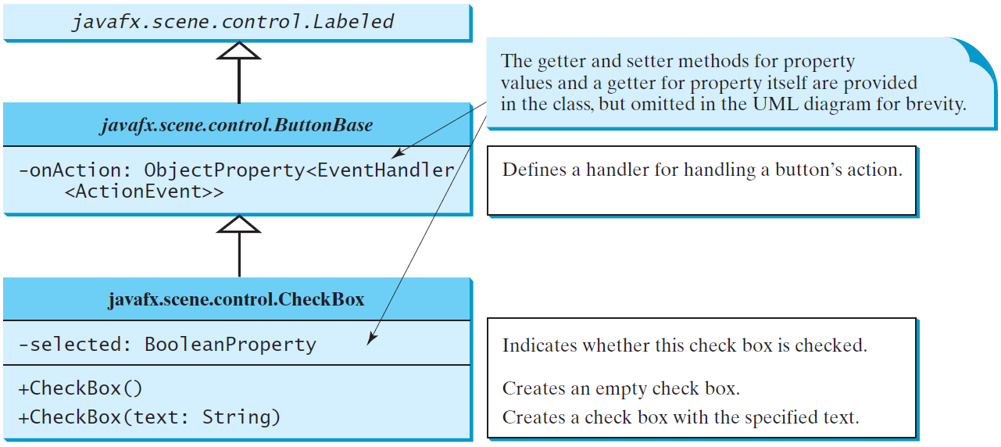
CheckBox
A CheckBox is used for the user to make a selection. Like Button, CheckBox inherits all the properties such as onAction, text, graphic, alignment, graphicTextGap, textFill, contentDisplay from ButtonBase and Labeled.

Slide 13
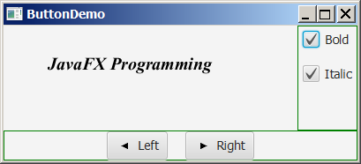
CheckBox Example
CheckBoxDemo
Run

Slide 14
import javafx.event.ActionEvent;
import javafx.event.EventHandler;
import javafx.geometry.Insets;
import javafx.scene.control.CheckBox;
import javafx.scene.layout.BorderPane;
import javafx.scene.layout.VBox;
import javafx.scene.text.Font;
import javafx.scene.text.FontPosture;
import javafx.scene.text.FontWeight;
public class CheckBoxDemo extends ButtonDemo {
@Override // Override the getPane() method in the super class
protected BorderPane getPane() {
BorderPane pane = super.getPane();
Font fontBoldItalic = Font.font("Times New Roman",
FontWeight.BOLD, FontPosture.ITALIC, 20);
Font fontBold = Font.font("Times New Roman",
FontWeight.BOLD, FontPosture.REGULAR, 20);
Font fontItalic = Font.font("Times New Roman",
FontWeight.NORMAL, FontPosture.ITALIC, 20);
Font fontNormal = Font.font("Times New Roman",
FontWeight.NORMAL, FontPosture.REGULAR, 20);
text.setFont(fontNormal);
VBox paneForCheckBoxes = new VBox(20);
paneForCheckBoxes.setPadding(new Insets(5, 5, 5, 5));
paneForCheckBoxes.setStyle("-fx-border-color: green");
CheckBox chkBold = new CheckBox("Bold");
CheckBox chkItalic = new CheckBox("Italic");
paneForCheckBoxes.getChildren().addAll(chkBold, chkItalic);
pane.setRight(paneForCheckBoxes);
EventHandler<ActionEvent> handler = e -> {
if (chkBold.isSelected() && chkItalic.isSelected()) {
text.setFont(fontBoldItalic); // Both check boxes checked
}
else if (chkBold.isSelected()) {
text.setFont(fontBold); // The Bold check box checked
}
else if (chkItalic.isSelected()) {
text.setFont(fontItalic); // The Italic check box checked
}
else {
text.setFont(fontNormal); // Both check boxes unchecked
}
};
chkBold.setOnAction(handler);
chkItalic.setOnAction(handler);
return pane; // Return a new pane
}
/**
* The main method is only needed for the IDE with limited
* JavaFX support. Not needed for running from the command line.
*/
public static void main(String[] args) {
launch(args);
}
}

Slide 15
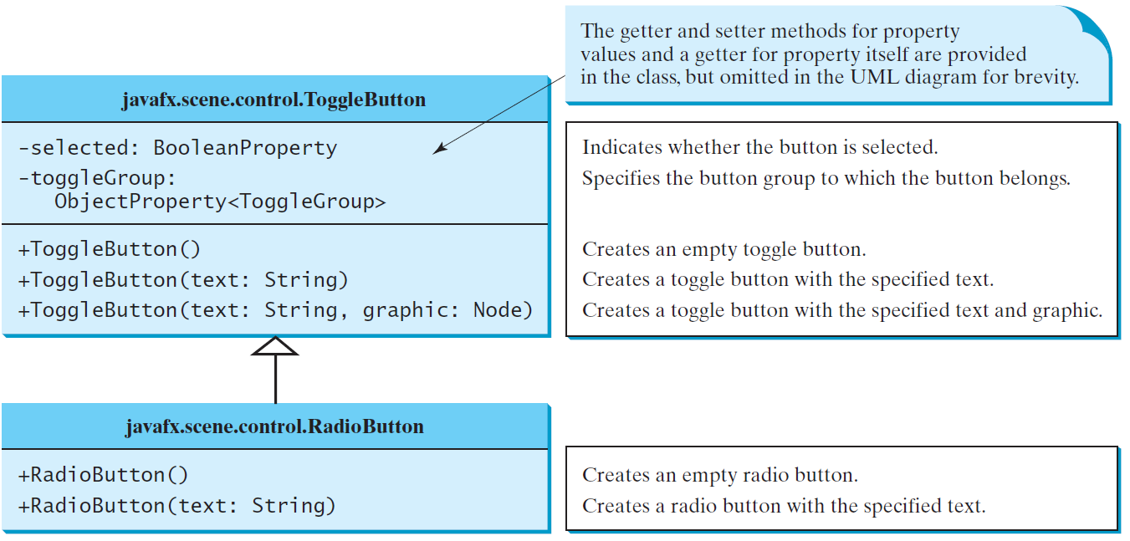
RadioButton
Radio buttons, also known as option buttons, enable you to choose a single item from a group of choices. In appearance radio buttons resemble check boxes, but check boxes display a square that is either checked or blank, whereas radio buttons display a circle that is either filled (if selected) or blank (if not selected).

Slide 16
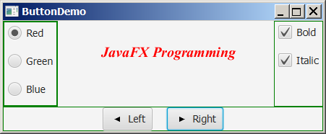
RadioButton Example
RadioButtonDemo
Run

Slide 17
import static javafx.application.Application.launch;
import javafx.geometry.Insets;
import javafx.scene.control.RadioButton;
import javafx.scene.control.ToggleGroup;
import javafx.scene.layout.BorderPane;
import javafx.scene.layout.VBox;
import javafx.scene.paint.Color;
public class RadioButtonDemo extends CheckBoxDemo {
@Override // Override the getPane() method in the super class
protected BorderPane getPane() {
BorderPane pane = super.getPane();
VBox paneForRadioButtons = new VBox(20);
paneForRadioButtons.setPadding(new Insets(5, 5, 5, 5));
paneForRadioButtons.setStyle("-fx-border-color: green");
paneForRadioButtons.setStyle
("-fx-border-width: 2px; -fx-border-color: green");
RadioButton rbRed = new RadioButton("Red");
RadioButton rbGreen = new RadioButton("Green");
RadioButton rbBlue = new RadioButton("Blue");
paneForRadioButtons.getChildren().addAll(rbRed, rbGreen, rbBlue);
pane.setLeft(paneForRadioButtons);
ToggleGroup group = new ToggleGroup();
rbRed.setToggleGroup(group);
rbGreen.setToggleGroup(group);
rbBlue.setToggleGroup(group);
rbRed.setOnAction(e -> {
if (rbRed.isSelected()) {
text.setFill(Color.RED);
}
});
rbGreen.setOnAction(e -> {
if (rbGreen.isSelected()) {
text.setFill(Color.GREEN);
}
});
rbBlue.setOnAction(e -> {
if (rbBlue.isSelected()) {
text.setFill(Color.BLUE);
}
});
return pane;
}
/**
* The main method is only needed for the IDE with limited
* JavaFX support. Not needed for running from the command line.
*/
public static void main(String[] args) {
launch(args);
}
}

Slide 18
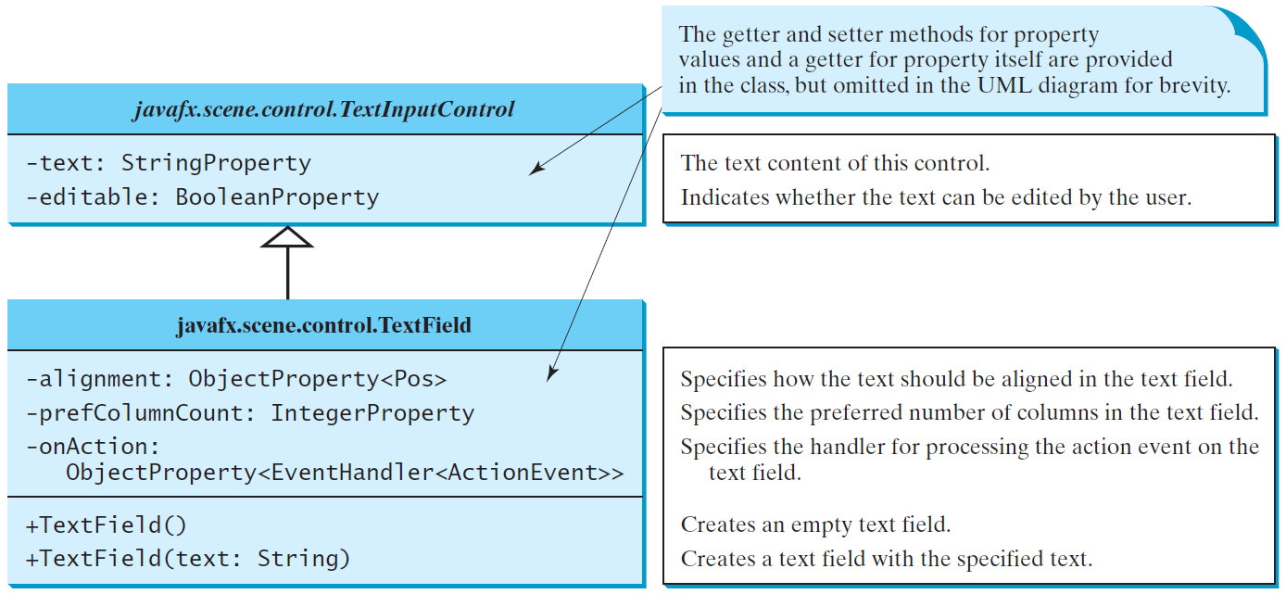
TextField
A text field can be used to enter or display a string. TextField is a subclass of TextInputControl.

Slide 19
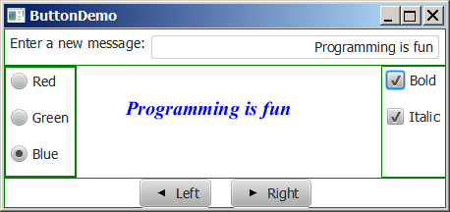
TextField Example
TextFieldDemo
Run

Slide 20
import static javafx.application.Application.launch;
import javafx.geometry.Insets;
import javafx.geometry.Pos;
import javafx.scene.control.Label;
import javafx.scene.control.TextField;
import javafx.scene.layout.BorderPane;
public class TextFieldDemo extends RadioButtonDemo {
@Override // Override the getPane() method in the super class
protected BorderPane getPane() {
BorderPane pane = super.getPane();
BorderPane paneForTextField = new BorderPane();
paneForTextField.setPadding(new Insets(5, 5, 5, 5));
paneForTextField.setStyle("-fx-border-color: green");
paneForTextField.setLeft(new Label("Enter a new message: "));
TextField tf = new TextField();
tf.setAlignment(Pos.BOTTOM_RIGHT);
paneForTextField.setCenter(tf);
pane.setTop(paneForTextField);
tf.setOnAction(e -> text.setText(tf.getText()));
return pane;
}
/**
* The main method is only needed for the IDE with limited
* JavaFX support. Not needed for running from the command line.
*/
public static void main(String[] args) {
launch(args);
}
}

Slide 21
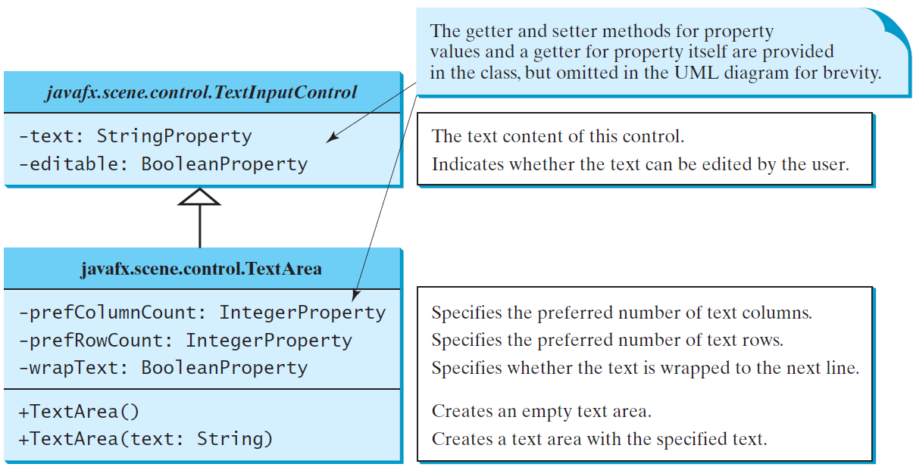
TextArea
A TextArea enables the user to enter multiple lines of text.

Slide 22
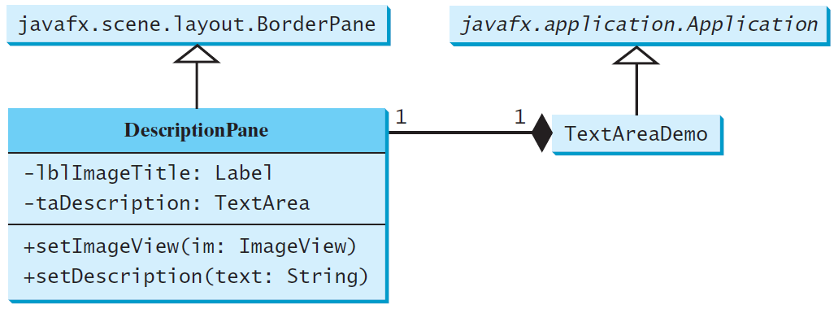
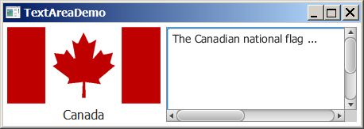
TextArea Example
DescriptionPane
TextAreaDemo
Run

Slide 23
import javafx.geometry.Insets;
import javafx.scene.control.Label;
import javafx.scene.control.ContentDisplay;
import javafx.scene.control.ScrollPane;
import javafx.scene.control.TextArea;
import javafx.scene.image.ImageView;
import javafx.scene.layout.BorderPane;
import javafx.scene.text.Font;
public class DescriptionPane extends BorderPane {
/** Label for displaying an image and a title */
private Label lblImageTitle = new Label();
/** Text area for displaying text */
private TextArea taDescription = new TextArea();
public DescriptionPane() {
// Center the icon and text and place the text under the icon
lblImageTitle.setContentDisplay(ContentDisplay.TOP);
lblImageTitle.setPrefSize(200, 100);
// Set the font in the label and the text field
lblImageTitle.setFont(new Font("SansSerif", 16));
taDescription.setFont(new Font("Serif", 14));
// taDescription.setWrapText(true);
// taDescription.setEditable(false);
// Create a scroll pane to hold the text area
ScrollPane scrollPane = new ScrollPane(taDescription);
// Place label and scroll pane in the border pane
setLeft(lblImageTitle);
setCenter(scrollPane);
setPadding(new Insets(5, 5, 5, 5));
}
/** Set the title */
public void setTitle(String title) {
lblImageTitle.setText(title);
}
/** Set the image view */
public void setImageView(ImageView icon) {
lblImageTitle.setGraphic(icon);
}
/** Set the text description */
public void setDescription(String text) {
taDescription.setText(text);
}
}

Slide 24
import javafx.application.Application;
import javafx.stage.Stage;
import javafx.scene.Scene;
import javafx.scene.image.ImageView;
public class TextAreaDemo extends Application {
@Override // Override the start method in the Application class
public void start(Stage primaryStage) {
// Declare and create a description pane
DescriptionPane descriptionPane = new DescriptionPane();
// Set title, text and image in the description pane
descriptionPane.setTitle("Canada");
String description = "The Canadian national flag ...";
descriptionPane.setImageView(new ImageView("image/ca.gif"));
descriptionPane.setDescription(description);
// Create a scene and place it in the stage
Scene scene = new Scene(descriptionPane, 450, 200);
primaryStage.setTitle("TextAreaDemo"); // Set the stage title
primaryStage.setScene(scene); // Place the scene in the stage
primaryStage.show(); // Display the stage
}
/**
* The main method is only needed for the IDE with limited
* JavaFX support. Not needed for running from the command line.
*/
public static void main(String[] args) {
launch(args);
}
}

Slide 25
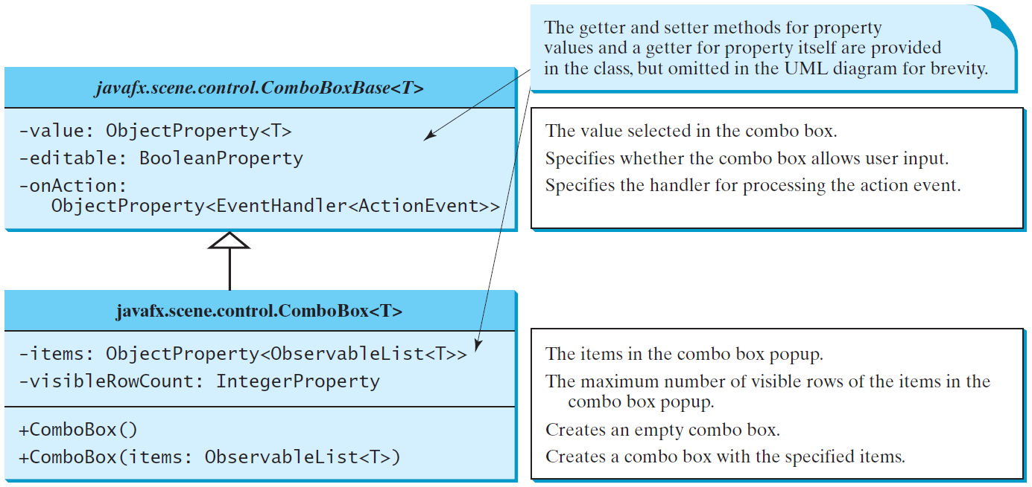
ComboBox
A combo box, also known as a choice list or drop-down list, contains a list of items from which the user can choose.

Slide 26
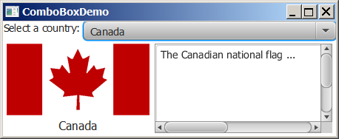
ComboBox Example
This example lets users view an image and a description of a country's flag by selecting the country from a combo box.
ComboBoxDemo
Run

Slide 27
import javafx.application.Application;
import javafx.stage.Stage;
import javafx.collections.FXCollections;
import javafx.collections.ObservableList;
import javafx.scene.Scene;
import javafx.scene.control.ComboBox;
import javafx.scene.control.Label;
import javafx.scene.image.ImageView;
import javafx.scene.layout.BorderPane;
public class ComboBoxDemo extends Application {
// Declare an array of Strings for flag titles
private String[] flagTitles = {"Canada", "China", "Denmark",
"France", "Germany", "India", "Norway", "United Kingdom",
"United States of America"};
// Declare an ImageView array for the national flags of 9 countries
private ImageView[] flagImage = {new ImageView("image/ca.gif"),
new ImageView("image/china.gif"),
new ImageView("image/denmark.gif"),
new ImageView("image/fr.gif"),
new ImageView("image/germany.gif"),
new ImageView("image/india.gif"),
new ImageView("image/norway.gif"),
new ImageView("image/uk.gif"), new ImageView("image/us.gif")};
// Declare an array of strings for flag descriptions
private String[] flagDescription = new String[9];
// Declare and create a description pane
private DescriptionPane descriptionPane = new DescriptionPane();
// Create a combo box for selecting countries
private ComboBox<String> cbo = new ComboBox<>(); // flagTitles);
@Override // Override the start method in the Application class
public void start(Stage primaryStage) {
// Set text description
flagDescription[0] = "The Canadian national flag ...";
flagDescription[1] = "Description for China ... ";
flagDescription[2] = "Description for Denmark ... ";
flagDescription[3] = "Description for France ... ";
flagDescription[4] = "Description for Germany ... ";
flagDescription[5] = "Description for India ... ";
flagDescription[6] = "Description for Norway ... ";
flagDescription[7] = "Description for UK ... ";
flagDescription[8] = "Description for US ... ";
// Set the first country (Canada) for display
setDisplay(0);
// Add combo box and description pane to the border pane
BorderPane pane = new BorderPane();
BorderPane paneForComboBox = new BorderPane();
paneForComboBox.setLeft(new Label("Select a country: "));
paneForComboBox.setCenter(cbo);
pane.setTop(paneForComboBox);
cbo.setPrefWidth(400);
cbo.setValue("Canada");
ObservableList<String> items =
FXCollections.observableArrayList(flagTitles);
cbo.getItems().addAll(items);
pane.setCenter(descriptionPane);

Slide 28
// Display the selected country
cbo.setOnAction(e -> setDisplay(items.indexOf(cbo.getValue())));
// Create a scene and place it in the stage
Scene scene = new Scene(pane, 450, 170);
primaryStage.setTitle("ComboBoxDemo"); // Set the stage title
primaryStage.setScene(scene); // Place the scene in the stage
primaryStage.show(); // Display the stage
}
/** Set display information on the description pane */
public void setDisplay(int index) {
descriptionPane.setTitle(flagTitles[index]);
descriptionPane.setImageView(flagImage[index]);
descriptionPane.setDescription(flagDescription[index]);
}
/**
* The main method is only needed for the IDE with limited
* JavaFX support. Not needed for running from the command line.
*/
public static void main(String[] args) {
launch(args);
}
}

Slide 29
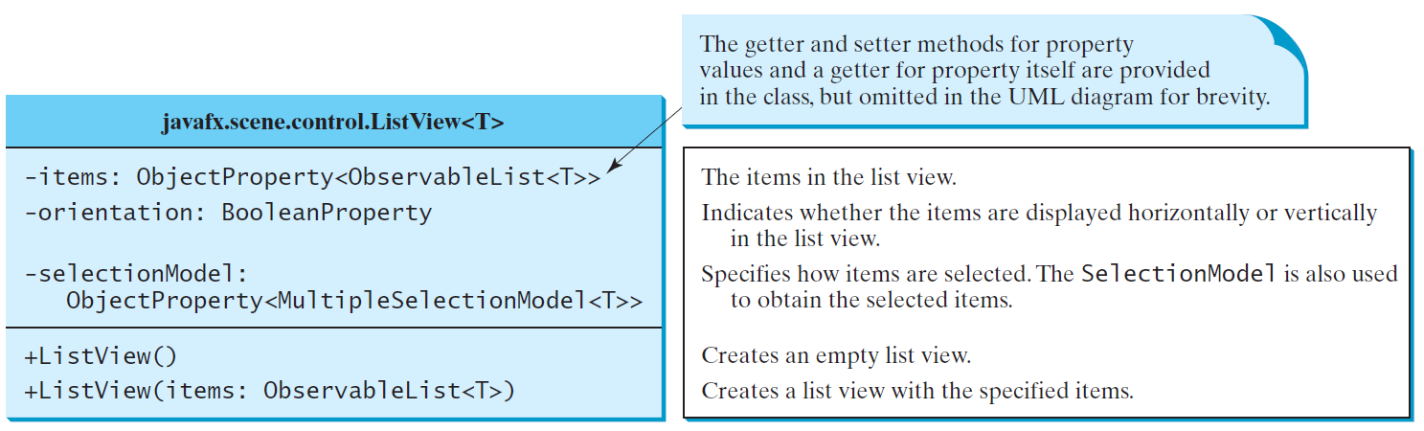
ListView
A list view is a component that performs basically the same function as a combo box, but it enables the user to choose a single value or multiple values.

Slide 30
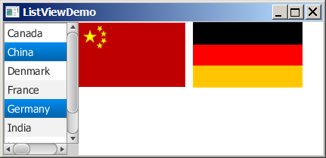
Example: Using ListView
This example gives a program that lets users select countries in a list and display the flags of the selected countries in the labels.
ListViewDemo
Run

Slide 31
import javafx.application.Application;
import javafx.stage.Stage;
import javafx.collections.FXCollections;
import javafx.scene.Scene;
import javafx.scene.control.ListView;
import javafx.scene.control.ScrollPane;
import javafx.scene.control.SelectionMode;
import javafx.scene.image.ImageView;
import javafx.scene.layout.BorderPane;
import javafx.scene.layout.FlowPane;
public class ListViewDemo extends Application {
// Declare an array of Strings for flag titles
private String[] flagTitles = {"Canada", "China", "Denmark",
"France", "Germany", "India", "Norway", "United Kingdom",
"United States of America"};
// Declare an ImageView array for the national flags of 9 countries
private ImageView[] ImageViews = {
new ImageView("image/ca.gif"),
new ImageView("image/china.gif"),
new ImageView("image/denmark.gif"),
new ImageView("image/fr.gif"),
new ImageView("image/germany.gif"),
new ImageView("image/india.gif"),
new ImageView("image/norway.gif"),
new ImageView("image/uk.gif"),
new ImageView("image/us.gif")
};
@Override // Override the start method in the Application class
public void start(Stage primaryStage) {
ListView<String> lv = new ListView<>
(FXCollections.observableArrayList(flagTitles));
lv.setPrefSize(400, 400);
lv.getSelectionModel().setSelectionMode(SelectionMode.MULTIPLE);
// Create a pane to hold image views
FlowPane imagePane = new FlowPane(10, 10);
BorderPane pane = new BorderPane();
pane.setLeft(new ScrollPane(lv));
pane.setCenter(imagePane);
lv.getSelectionModel().selectedItemProperty().addListener(
ov -> {
imagePane.getChildren().clear();
for (Integer i: lv.getSelectionModel().getSelectedIndices()) {
imagePane.getChildren().add(ImageViews[i]);
}
});
// Create a scene and place it in the stage
Scene scene = new Scene(pane, 450, 170);
primaryStage.setTitle("ListViewDemo"); // Set the stage title
primaryStage.setScene(scene); // Place the scene in the stage
primaryStage.show(); // Display the stage
}
/**
* The main method is only needed for the IDE with limited
* JavaFX support. Not needed for running from the command line.
*/
public static void main(String[] args) {
launch(args);
}
}

Slide 32
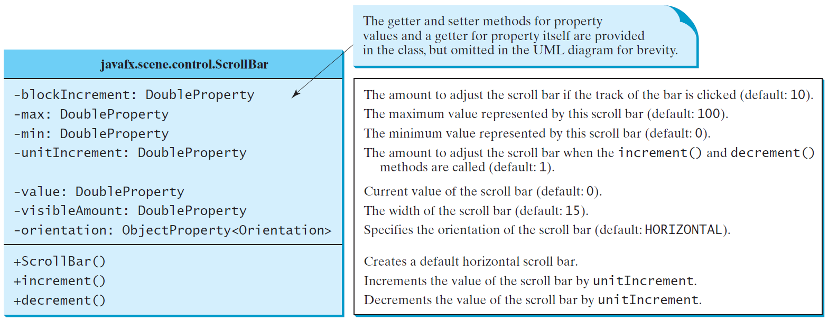
ScrollBar
A scroll bar is a control that enables the user to select from a range of values. The scrollbar appears in two styles: horizontal and vertical.

Slide 33
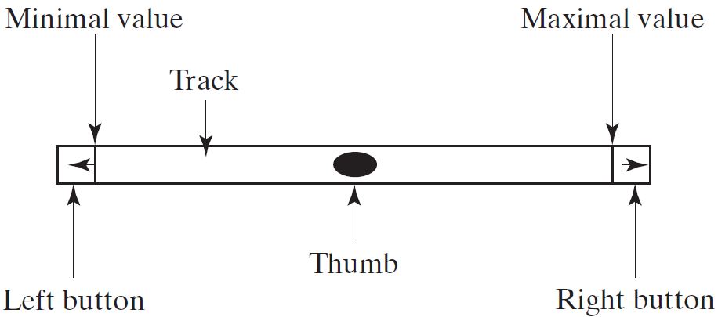
Scroll Bar Properties

Slide 34
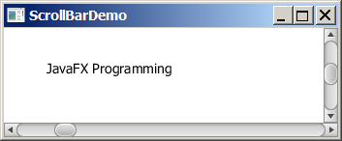
Example: Using Scrollbars
This example uses horizontal and vertical scrollbars to control a message displayed on a panel. The horizontal scrollbar is used to move the message to the left or the right, and the vertical scrollbar to move it up and down.
ScrollBarDemo
Run

Slide 35
import javafx.application.Application;
import javafx.stage.Stage;
import javafx.geometry.Orientation;
import javafx.scene.Scene;
import javafx.scene.control.ScrollBar;
import javafx.scene.layout.BorderPane;
import javafx.scene.layout.Pane;
import javafx.scene.text.Text;
public class ScrollBarDemo extends Application {
@Override // Override the start method in the Application class
public void start(Stage primaryStage) {
Text text = new Text(20, 20, "JavaFX Programming");
ScrollBar sbHorizontal = new ScrollBar();
ScrollBar sbVertical = new ScrollBar();
sbVertical.setOrientation(Orientation.VERTICAL);
// Create a text in a pane
Pane paneForText = new Pane();
paneForText.getChildren().add(text);
// Create a border pane to hold text and scroll bars
BorderPane pane = new BorderPane();
pane.setCenter(paneForText);
pane.setBottom(sbHorizontal);
pane.setRight(sbVertical);
// Listener for horizontal scroll bar value change
sbHorizontal.valueProperty().addListener(ov ->
text.setX(sbHorizontal.getValue() * paneForText.getWidth() /
sbHorizontal.getMax()));
// Listener for vertical scroll bar value change
sbVertical.valueProperty().addListener(ov ->
text.setY(sbVertical.getValue() * paneForText.getHeight() /
sbVertical.getMax()));
// Create a scene and place it in the stage
Scene scene = new Scene(pane, 450, 170);
primaryStage.setTitle("ScrollBarDemo"); // Set the stage title
primaryStage.setScene(scene); // Place the scene in the stage
primaryStage.show(); // Display the stage
}
/**
* The main method is only needed for the IDE with limited
* JavaFX support. Not needed for running from the command line.
*/
public static void main(String[] args) {
launch(args);
}
}

Slide 36
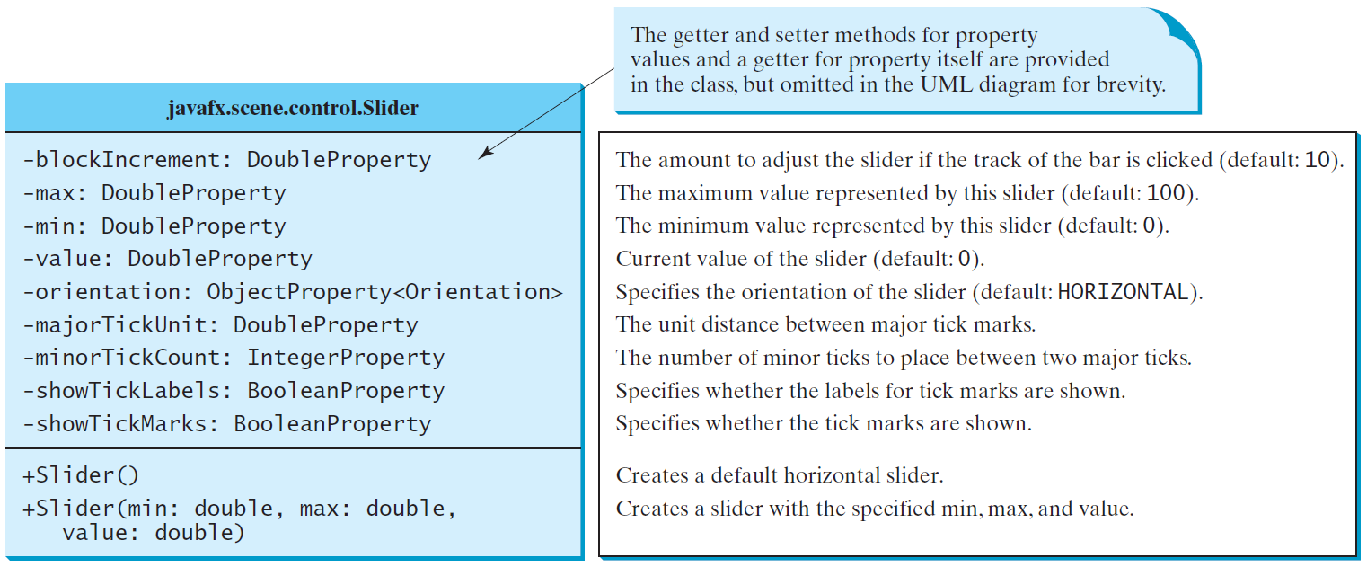
Slider
Slider is similar to ScrollBar, but Slider has more properties and can appear in many forms.

Slide 37
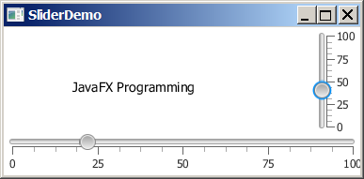
Example: Using Sliders
Rewrite the preceding program using the sliders to control a message displayed on a panel instead of using scroll bars.
SliderDemo
Run

Slide 38
import javafx.application.Application;
import javafx.stage.Stage;
import javafx.geometry.Orientation;
import javafx.scene.Scene;
import javafx.scene.control.Slider;
import javafx.scene.layout.BorderPane;
import javafx.scene.layout.Pane;
import javafx.scene.text.Text;
public class SliderDemo extends Application {
@Override // Override the start method in the Application class
public void start(Stage primaryStage) {
Text text = new Text(20, 20, "JavaFX Programming");
Slider slHorizontal = new Slider();
slHorizontal.setShowTickLabels(true);
slHorizontal.setShowTickMarks(true);
Slider slVertical = new Slider();
slVertical.setOrientation(Orientation.VERTICAL);
slVertical.setShowTickLabels(true);
slVertical.setShowTickMarks(true);
slVertical.setValue(100);
// Create a text in a pane
Pane paneForText = new Pane();
paneForText.getChildren().add(text);
// Create a border pane to hold text and scroll bars
BorderPane pane = new BorderPane();
pane.setCenter(paneForText);
pane.setBottom(slHorizontal);
pane.setRight(slVertical);
slHorizontal.valueProperty().addListener(ov ->
text.setX(slHorizontal.getValue() * paneForText.getWidth() /
slHorizontal.getMax()));
slVertical.valueProperty().addListener(ov ->
text.setY((slVertical.getMax() - slVertical.getValue())
* paneForText.getHeight() / slVertical.getMax()));
// Create a scene and place it in the stage
Scene scene = new Scene(pane, 450, 170);
primaryStage.setTitle("SliderDemo"); // Set the stage title
primaryStage.setScene(scene); // Place the scene in the stage
primaryStage.show(); // Display the stage
}
/**
* The main method is only needed for the IDE with limited
* JavaFX support. Not needed for running from the command line.
*/
public static void main(String[] args) {
launch(args);
}
}

Slide 39
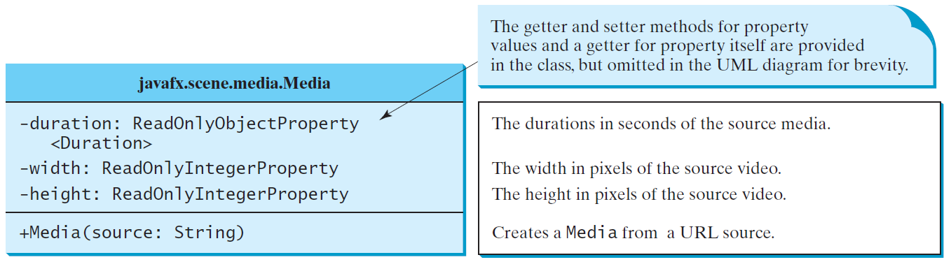
Media
You can use the Media class to obtain the source of the media, the MediaPlayer class to play and control the media, and the MediaView class to display the video.

Slide 40
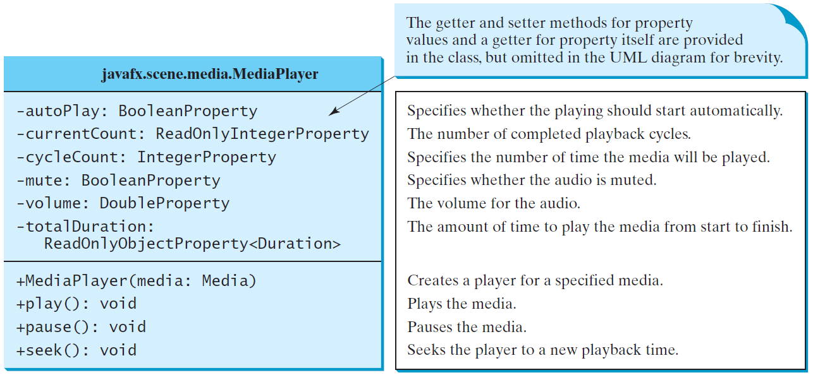
MediaPlayer
The MediaPlayer class playes and controls the media with properties such as autoPlay, currentCount, cycleCount, mute, volume, and totalDuration.

Slide 41
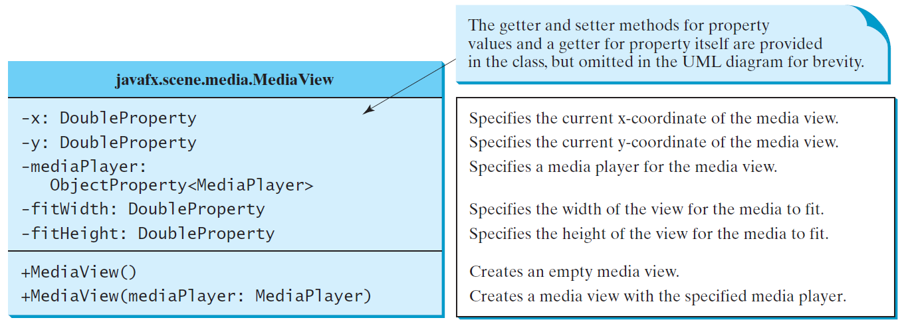
MediaView
The MediaView class is a subclass of Node that provides a view of the Media being played by a MediaPlayer. The MediaView class provides the properties for viewing the media.

Slide 42
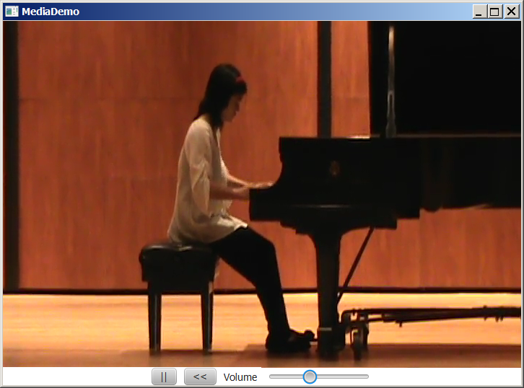
Example: Using Media
This example displays a video in a view. You can use the play/pause button to play or pause the video and use the rewind button to restart the video, and use the slider to control the volume of the audio.
MediaDemo
Run

Slide 43
import javafx.application.Application;
import javafx.stage.Stage;
import javafx.geometry.Pos;
import javafx.scene.Scene;
import javafx.scene.control.Button;
import javafx.scene.control.Label;
import javafx.scene.control.Slider;
import javafx.scene.layout.BorderPane;
import javafx.scene.layout.HBox;
import javafx.scene.layout.Region;
import javafx.scene.media.Media;
import javafx.scene.media.MediaPlayer;
import javafx.scene.media.MediaView;
import javafx.util.Duration;
public class MediaDemo extends Application {
private static final String MEDIA_URL =
"https://liveexample.pearsoncmg.com/common/sample.mp4";
@Override // Override the start method in the Application class
public void start(Stage primaryStage) {
Media media = new Media(MEDIA_URL);
MediaPlayer mediaPlayer = new MediaPlayer(media);
MediaView mediaView = new MediaView(mediaPlayer);
Button playButton = new Button(">");
playButton.setOnAction(e -> {
if (playButton.getText().equals(">")) {
mediaPlayer.play();
playButton.setText("||");
} else {
mediaPlayer.pause();
playButton.setText(">");
}
});
Button rewindButton = new Button("<<");
rewindButton.setOnAction(e -> mediaPlayer.seek(Duration.ZERO));
Slider slVolume = new Slider();
slVolume.setPrefWidth(150);
slVolume.setMaxWidth(Region.USE_PREF_SIZE);
slVolume.setMinWidth(30);
slVolume.setValue(50);
mediaPlayer.volumeProperty().bind(
slVolume.valueProperty().divide(100));
HBox hBox = new HBox(10);
hBox.setAlignment(Pos.CENTER);
hBox.getChildren().addAll(playButton, rewindButton,
new Label("Volume"), slVolume);
BorderPane pane = new BorderPane();
pane.setCenter(mediaView);
pane.setBottom(hBox);
// Create a scene and place it in the stage
Scene scene = new Scene(pane, 650, 500);
primaryStage.setTitle("MediaDemo"); // Set the stage title
primaryStage.setScene(scene); // Place the scene in the stage
primaryStage.show(); // Display the stage
}
/**
* The main method is only needed for the IDE with limited
* JavaFX support. Not needed for running from the command line.
*/
public static void main(String[] args) {
launch(args);
}
}

Slide 44
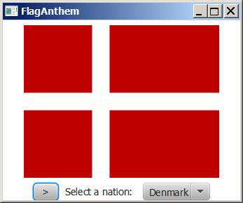
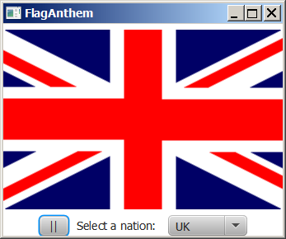
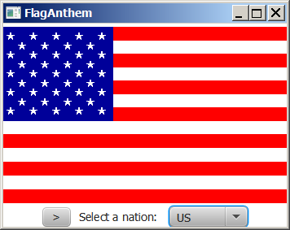
Case Study: National Flags and Anthems
This case study presents a program that displays a nation’s flag and plays its anthem.
FlagAnthem
Run

Slide 45
import javafx.application.Application;
import javafx.collections.FXCollections;
import javafx.collections.ObservableList;
import javafx.stage.Stage;
import javafx.geometry.Pos;
import javafx.scene.Scene;
import javafx.scene.control.Button;
import javafx.scene.control.ComboBox;
import javafx.scene.control.Label;
import javafx.scene.image.Image;
import javafx.scene.image.ImageView;
import javafx.scene.layout.BorderPane;
import javafx.scene.layout.HBox;
import javafx.scene.media.Media;
import javafx.scene.media.MediaPlayer;
public class FlagAnthem extends Application {
private final static int NUMBER_OF_NATIONS = 7;
private final static String URLBase =
"https://liveexample.pearsoncmg.com/common";
private int currentIndex = 0;
@Override // Override the start method in the Application class
public void start(Stage primaryStage) {
Image[] images = new Image[NUMBER_OF_NATIONS];
MediaPlayer[] mp = new MediaPlayer[NUMBER_OF_NATIONS];
// Load images and audio
for (int i = 0; i < NUMBER_OF_NATIONS; i++) {
images[i] = new Image(URLBase + "/image/flag" + i + ".gif");
mp[i] = new MediaPlayer(new Media(
URLBase + "/audio/anthem/anthem" + i + ".mp3"));
}
Button btPlayPause = new Button(">");
btPlayPause.setOnAction(e -> {
if (btPlayPause.getText().equals(">")) {
btPlayPause.setText("||");
mp[currentIndex].pause();
}
else {
btPlayPause.setText(">");
mp[currentIndex].play();
}
});
ImageView imageView = new ImageView(images[currentIndex]);
ComboBox<String> cboNation = new ComboBox<>();
ObservableList<String> items = FXCollections.observableArrayList
("Denmark", "Germany", "China", "India", "Norway", "UK", "US");
cboNation.getItems().addAll(items);
cboNation.setValue(items.get(0));
cboNation.setOnAction(e -> {
mp[currentIndex].stop();
currentIndex = items.indexOf(cboNation.getValue());
imageView.setImage(images[currentIndex]);
mp[currentIndex].play();
});
HBox hBox = new HBox(10);
hBox.getChildren().addAll(btPlayPause,
new Label("Select a nation: "), cboNation);
hBox.setAlignment(Pos.CENTER);

Slide 46
// Create a pane to hold nodes
BorderPane pane = new BorderPane();
pane.setCenter(imageView);
pane.setBottom(hBox);
// Create a scene and place it in the stage
Scene scene = new Scene(pane, 350, 270);
primaryStage.setTitle("FlagAnthem"); // Set the stage title
primaryStage.setScene(scene); // Place the scene in the stage
primaryStage.show(); // Display the stage
}
/**
* The main method is only needed for the IDE with limited
* JavaFX support. Not needed for running from the command line.
*/
public static void main(String[] args) {
launch(args);
}
}

Slide 47
Drawing with Shapes and Text Property Binding Animation

Slide 48
Objectives
To use binding properties to synchronize property values (§14.5).
To display text using the Text class and create shapes using Line, Circle, Rectangle, Ellipse, Arc, Polygon, and Polyline (§14.11).
To develop the reusable GUI components ClockPane for displaying an analog clock (§14.12).

Slide 49
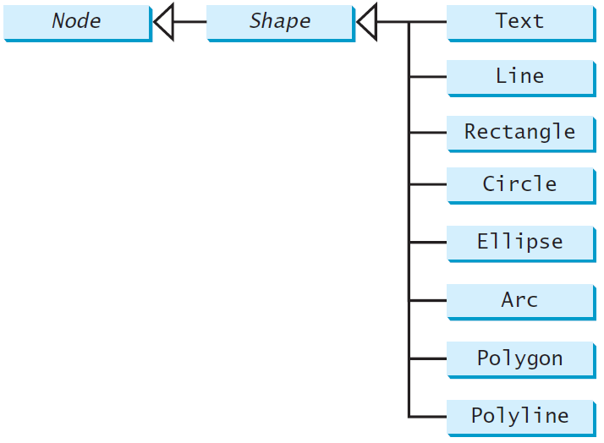
Shapes
JavaFX provides many shape classes for drawing texts, lines, circles, rectangles, ellipses, arcs, polygons, and polylines.

Slide 50
Display a Shape
This example displays a circle in the center of the pane.
ShowCircle
Run

Slide 51
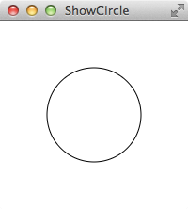
import javafx.application.Application;
import javafx.scene.Scene;
import javafx.scene.layout.Pane;
import javafx.scene.paint.Color;
import javafx.scene.shape.Circle;
import javafx.stage.Stage;
public class ShowCircle extends Application {
@Override // Override the start method in the Application class
public void start(Stage primaryStage) {
// Create a circle and set its properties
Circle circle = new Circle();
circle.setCenterX(100);
circle.setCenterY(100);
circle.setRadius(50);
circle.setStroke(Color.BLACK);
circle.setFill(null);
// Create a pane to hold the circle
Pane pane = new Pane();
pane.getChildren().add(circle);
// Create a scene and place it in the stage
Scene scene = new Scene(pane, 200, 200);
primaryStage.setTitle("ShowCircle"); // Set the stage title
primaryStage.setScene(scene); // Place the scene in the stage
primaryStage.show(); // Display the stage
}
/**
* The main method is only needed for the IDE with limited
* JavaFX support. Not needed for running from the command line.
*/
public static void main(String[] args) {
launch(args);
}
}

Slide 52
Binding Properties
JavaFX introduces a new concept called binding property that enables a target object to be bound to a source object.
If the value in the source object changes, the target property is also changed automatically.
The target object is simply called a binding object or a binding property.
ShowCircleCentered
Run

Slide 53
import javafx.application.Application;
import javafx.scene.Scene;
import javafx.scene.layout.Pane;
import javafx.scene.paint.Color;
import javafx.scene.shape.Circle;
import javafx.stage.Stage;
public class ShowCircleCentered extends Application {
@Override // Override the start method in the Application class
public void start(Stage primaryStage) {
// Create a pane to hold the circle
Pane pane = new Pane();
// Create a circle and set its properties
Circle circle = new Circle();
circle.centerXProperty().bind(pane.widthProperty().divide(2));
circle.centerYProperty().bind(pane.heightProperty().divide(2));
circle.setRadius(50);
circle.setStroke(Color.BLACK);
circle.setFill(Color.WHITE);
pane.getChildren().add(circle); // Add circle to the pane

Slide 54
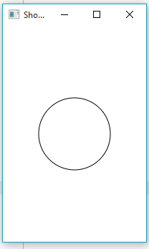
// Create a scene and place it in the stage
Scene scene = new Scene(pane, 200, 200);
primaryStage.setTitle("ShowCircleCentered"); // Set the stage title
primaryStage.setScene(scene); // Place the scene in the stage
primaryStage.show(); // Display the stage
}
/**
* The main method is only needed for the IDE with limited
* JavaFX support. Not needed for running from the command line.
*/
public static void main(String[] args) {
launch(args);
}
}

Slide 55
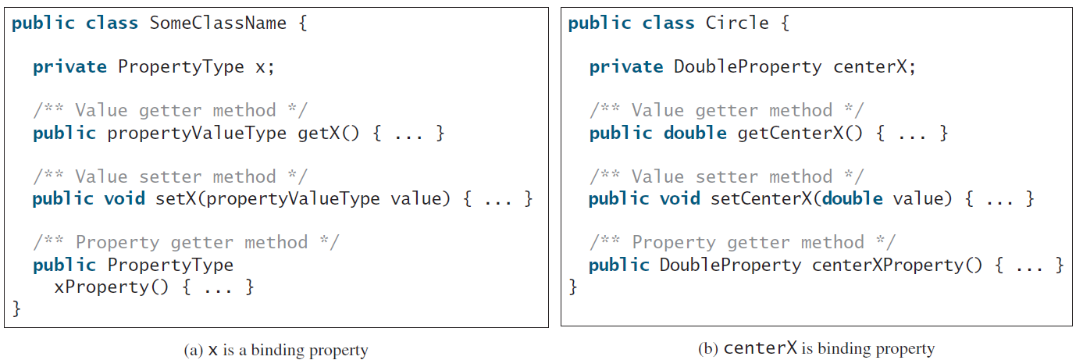
Binding Property: getter, setter, and property getter

Slide 56
Uni/Bidirectional Binding
import javafx.beans.property.DoubleProperty;
import javafx.beans.property.SimpleDoubleProperty;
public class BidirectionalBindingDemo {
public static void main(String[] args) {
DoubleProperty d1 = new SimpleDoubleProperty(1);
DoubleProperty d2 = new SimpleDoubleProperty(2);
d1.bindBidirectional(d2);
System.out.println("d1 is " + d1.getValue()
+ " and d2 is " + d2.getValue());
d1.setValue(50.1);
System.out.println("d1 is " + d1.getValue()
+ " and d2 is " + d2.getValue());
d2.setValue(70.2);
System.out.println("d1 is " + d1.getValue()
+ " and d2 is " + d2.getValue());
}
}
d1 is 2.0 and d2 is 2.0
d1 is 50.1 and d2 is 50.1
d1 is 70.2 and d2 is 70.2
BidirectionalBindingDemo
Run

Slide 57
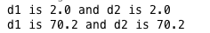
Uni/Bidirectional Binding, cont’
import javafx.beans.property.DoubleProperty;
import javafx.beans.property.SimpleDoubleProperty;
public class BindingDemo {
public static void main(String[] args) {
DoubleProperty d1 = new SimpleDoubleProperty(1);
DoubleProperty d2 = new SimpleDoubleProperty(2);
d1.bind(d2); // Bind d1 with d2
System.out.println("d1 is " + d1.getValue()
+ " and d2 is " + d2.getValue());
d2.setValue(70.2);
System.out.println("d1 is " + d1.getValue()
+ " and d2 is " + d2.getValue());
}
}
BindingDemo
Run

Slide 58
Listeners for Observable Objects
You can add a listener to process a value change in an observable object.
An instance of Observable is known as an observable object, which contains the addListener(InvalidationListener listener) method for adding a listener. Once the value is changed in the property, a listener is notified. The listener class should implement the InvalidationListener interface, which uses the invalidated(Observable o) method to handle the property value change. Every binding property is an instance of Observable.
ObservablePropertyDemo
Run

Slide 59
import javafx.beans.InvalidationListener;
import javafx.beans.Observable;
import javafx.beans.property.DoubleProperty;
import javafx.beans.property.SimpleDoubleProperty;
public class ObservablePropertyDemo {
public static void main(String[] args) {
DoubleProperty balance = new SimpleDoubleProperty();
balance.addListener(new InvalidationListener() {
public void invalidated(Observable ov) {
System.out.println("The new value is " +
balance.doubleValue());
}
});
balance.set(4.5);
}
}

Slide 60
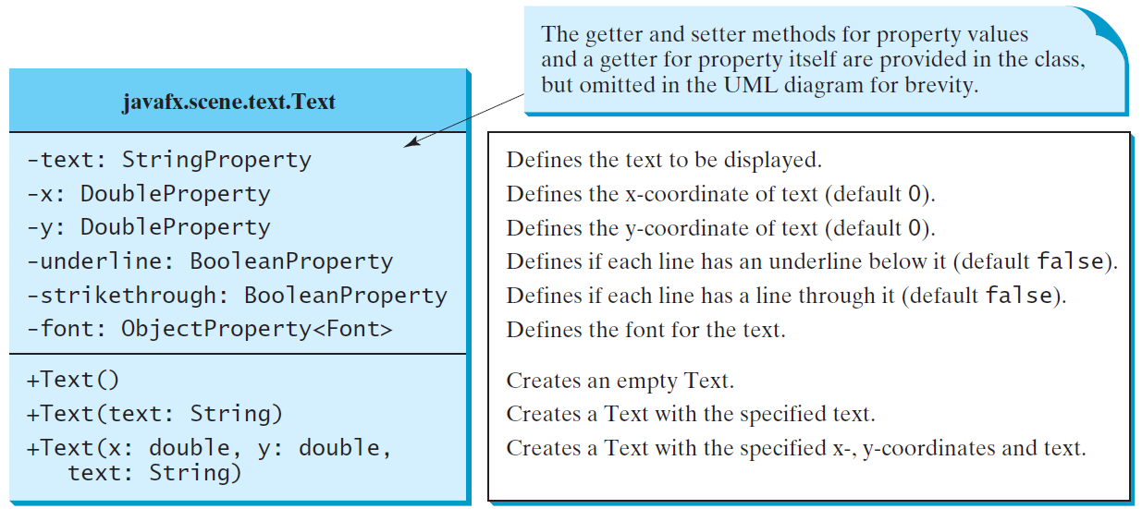
Text

Slide 61
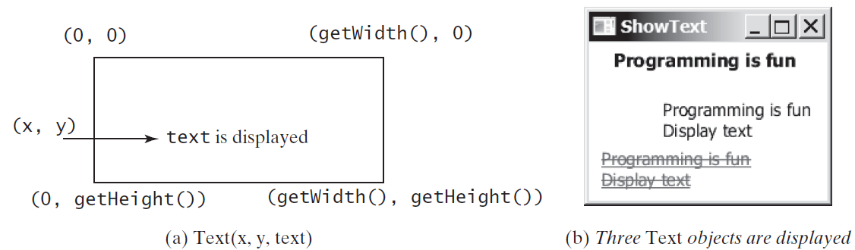
Text Example
ShowText
Run

Slide 62
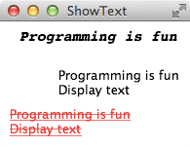
import javafx.application.Application;
import javafx.scene.Scene;
import javafx.scene.layout.Pane;
import javafx.scene.paint.Color;
import javafx.geometry.Insets;
import javafx.stage.Stage;
import javafx.scene.text.Text;
import javafx.scene.text.Font;
import javafx.scene.text.FontWeight;
import javafx.scene.text.FontPosture;
public class ShowText extends Application {
@Override // Override the start method in the Application class
public void start(Stage primaryStage) {
// Create a pane to hold the texts
Pane pane = new Pane();
pane.setPadding(new Insets(5, 5, 5, 5));
Text text1 = new Text(20, 20, "Programming is fun");
text1.setFont(Font.font("Courier", FontWeight.BOLD,
FontPosture.ITALIC, 15));
pane.getChildren().add(text1);
Text text2 = new Text(60, 60, "Programming is fun\nDisplay text");
pane.getChildren().add(text2);
Text text3 = new Text(10, 100, "Programming is fun\nDisplay text");
text3.setFill(Color.RED);
text3.setUnderline(true);
text3.setStrikethrough(true);
pane.getChildren().add(text3);
// Create a scene and place it in the stage
Scene scene = new Scene(pane);
primaryStage.setTitle("ShowText"); // Set the stage title
primaryStage.setScene(scene); // Place the scene in the stage
primaryStage.show(); // Display the stage
}
/**
* The main method is only needed for the IDE with limited
* JavaFX support. Not needed for running from the command line.
*/
public static void main(String[] args) {
launch(args);
}
}

Slide 63
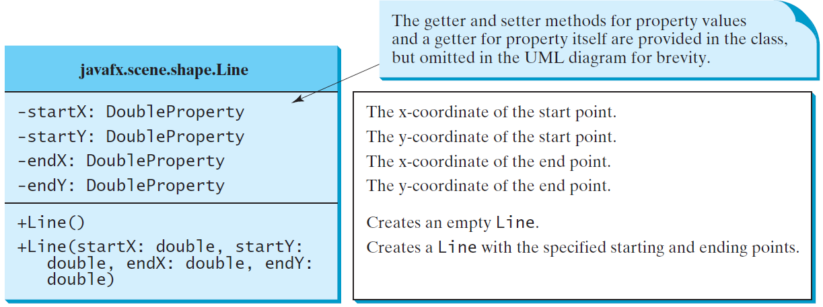
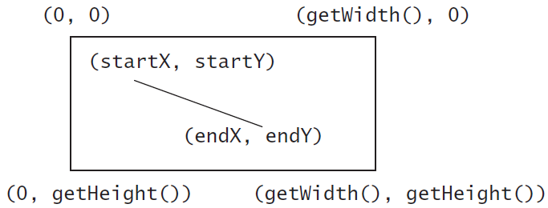
Line
ShowLine
Run

Slide 64

import javafx.application.Application;
import javafx.scene.Scene;
import javafx.scene.layout.Pane;
import javafx.scene.paint.Color;
import javafx.stage.Stage;
import javafx.scene.shape.Line;
public class ShowLine extends Application {
@Override // Override the start method in the Application class
public void start(Stage primaryStage) {
// Create a scene and place it in the stage
Scene scene = new Scene(new LinePane(), 200, 200);
primaryStage.setTitle("ShowLine"); // Set the stage title
primaryStage.setScene(scene); // Place the scene in the stage
primaryStage.show(); // Display the stage
}
public static void main(String[] args) {
launch(args);
}
}
class LinePane extends Pane {
public LinePane() {
Line line1 = new Line(10, 10, 10, 10);
line1.endXProperty().bind(widthProperty().subtract(10));
line1.endYProperty().bind(heightProperty().subtract(10));
line1.setStrokeWidth(5);
line1.setStroke(Color.GREEN);
getChildren().add(line1);
Line line2 = new Line(10, 10, 10, 10);
line2.startXProperty().bind(widthProperty().subtract(10));
line2.endYProperty().bind(heightProperty().subtract(10));
line2.setStrokeWidth(5);
line2.setStroke(Color.GREEN);
getChildren().add(line2);
}
}

Slide 65
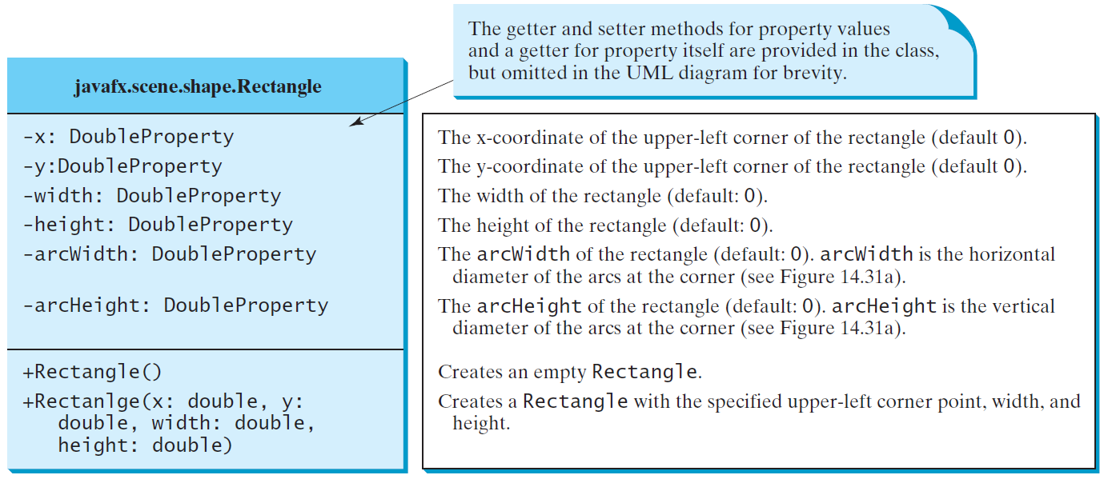
Rectangle

Slide 66
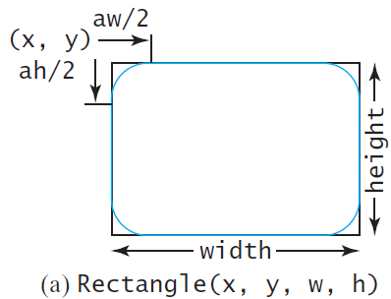
Rectangle Example
ShowRectangle
Run

Slide 67
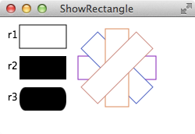
import java.util.Collections;
import javafx.application.Application;
import javafx.scene.Scene;
import javafx.scene.layout.Pane;
import javafx.scene.paint.Color;
import javafx.stage.Stage;
import javafx.scene.text.Text;
import javafx.scene.shape.Rectangle;
public class ShowRectangle extends Application {
@Override // Override the start method in the Application class
public void start(Stage primaryStage) {
// Create a pane
Pane pane = new Pane();
// Create rectangles and add to pane
Rectangle r1 = new Rectangle(25, 10, 60, 30);
r1.setStroke(Color.BLACK);
r1.setFill(Color.WHITE);
pane.getChildren().add(new Text(10, 27, "r1"));
pane.getChildren().add(r1);
Rectangle r2 = new Rectangle(25, 50, 60, 30);
pane.getChildren().add(new Text(10, 67, "r2"));
pane.getChildren().add(r2);
Rectangle r3 = new Rectangle(25, 90, 60, 30);
r3.setArcWidth(15);
r3.setArcHeight(25);
pane.getChildren().add(new Text(10, 107, "r3"));
pane.getChildren().add(r3);
for (int i = 0; i < 4; i++) {
Rectangle r = new Rectangle(100, 50, 100, 30);
r.setRotate(i * 360 / 8);
r.setStroke(Color.color(Math.random(), Math.random(),
Math.random()));
r.setFill(Color.WHITE);
pane.getChildren().add(r);
}
// Create a scene and place it in the stage
Scene scene = new Scene(pane, 250, 150);
primaryStage.setTitle("ShowRectangle"); // Set the stage title
primaryStage.setScene(scene); // Place the scene in the stage
primaryStage.show(); // Display the stage
}
/**
* The main method is only needed for the IDE with limited
* JavaFX support. Not needed for running from the command line.
*/
public static void main(String[] args) {
launch(args);
}
}

Slide 68
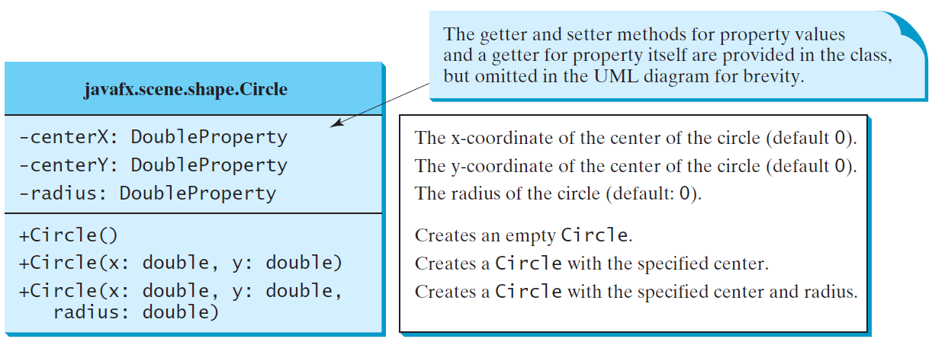
Circle

Slide 69
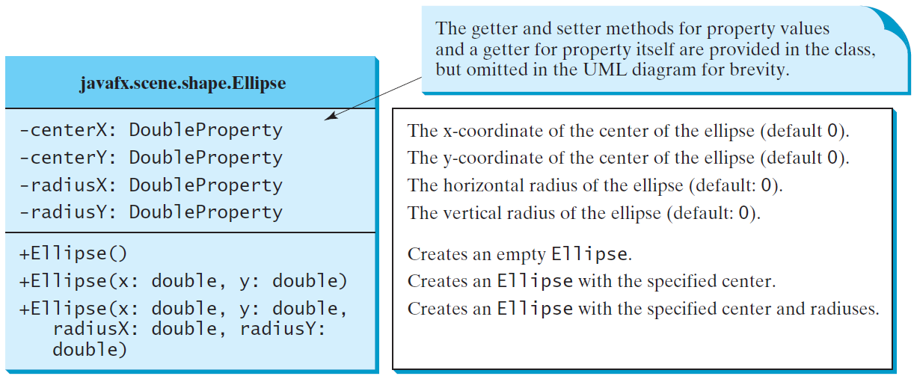
Ellipse
ShowEllipse
Run

Slide 70
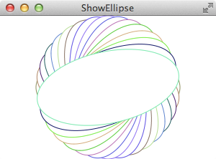
import javafx.application.Application;
import javafx.scene.Scene;
import javafx.scene.layout.Pane;
import javafx.scene.paint.Color;
import javafx.stage.Stage;
import javafx.scene.shape.Ellipse;
public class ShowEllipse extends Application {
@Override // Override the start method in the Application class
public void start(Stage primaryStage) {
// Create a pane
Pane pane = new Pane();
for (int i = 0; i < 16; i++) {
// Create an ellipse and add it to pane
Ellipse e1 = new Ellipse(150, 100, 100, 50);
e1.setStroke(Color.color(Math.random(), Math.random(),
Math.random()));
e1.setFill(Color.WHITE);
e1.setRotate(i * 180 / 16);
pane.getChildren().add(e1);
}
// Create a scene and place it in the stage
Scene scene = new Scene(pane, 300, 200);
primaryStage.setTitle("ShowEllipse"); // Set the stage title
primaryStage.setScene(scene); // Place the scene in the stage
primaryStage.show(); // Display the stage
}
public static void main(String[] args) {
launch(args);
}
}

Slide 71
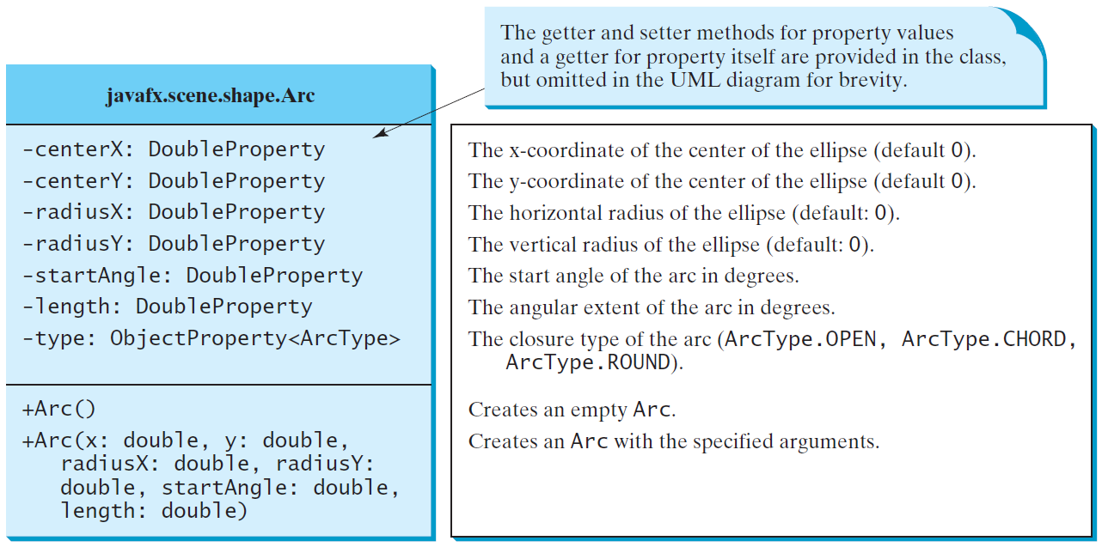
Arc

Slide 72
Arc Examples
ShowArc
Run

Slide 73
Polygon and Polyline

Slide 74
Polygon
ShowPolygon
Run

Slide 75
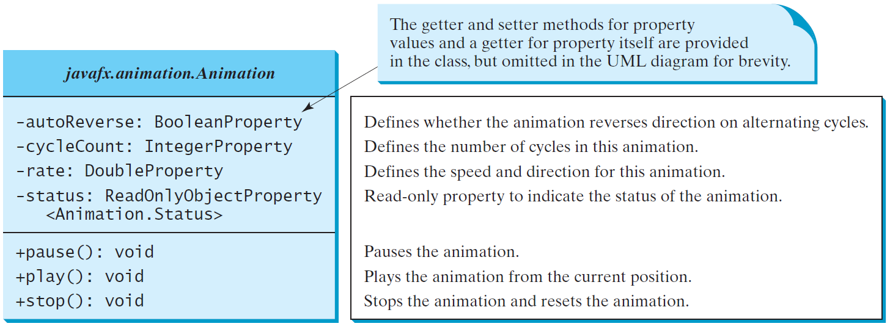
Animation
JavaFX provides the Animation class with the core functionality for all animations.

Slide 76
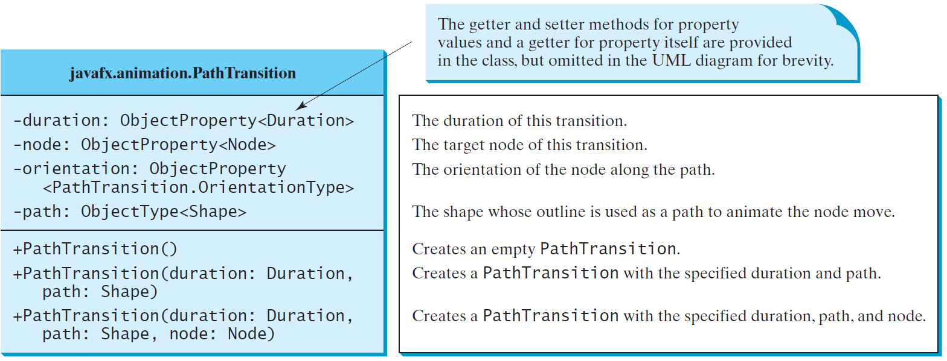
PathTransition
PathTransitionDemo
Run
FlagRisingAnimation
Run

Slide 77

import javafx.animation.PathTransition;
import javafx.animation.Timeline;
import javafx.application.Application;
import javafx.scene.Scene;
import javafx.scene.layout.Pane;
import javafx.scene.paint.Color;
import javafx.scene.shape.Rectangle;
import javafx.scene.shape.Circle;
import javafx.stage.Stage;
import javafx.util.Duration;
public class PathTransitionDemo extends Application {
@Override // Override the start method in the Application class
public void start(Stage primaryStage) {
// Create a pane
Pane pane = new Pane();
// Create a rectangle
Rectangle rectangle = new Rectangle (0, 0, 25, 50);
rectangle.setFill(Color.ORANGE);
// Create a circle
Circle circle = new Circle(125, 100, 50);
circle.setFill(Color.WHITE);
circle.setStroke(Color.BLACK);
// Add circle and rectangle to the pane
pane.getChildren().add(circle);
pane.getChildren().add(rectangle);
// Create a path transition
PathTransition pt = new PathTransition();
pt.setDuration(Duration.millis(4000));
pt.setPath(circle);
pt.setNode(rectangle);
pt.setOrientation(
PathTransition.OrientationType.ORTHOGONAL_TO_TANGENT);
pt.setCycleCount(Timeline.INDEFINITE);
pt.setAutoReverse(true);
pt.play(); // Start animation
circle.setOnMousePressed(e -> pt.pause());
circle.setOnMouseReleased(e -> pt.play());
// Create a scene and place it in the stage
Scene scene = new Scene(pane, 250, 200);
primaryStage.setTitle("PathTransitionDemo"); // Set the stage title
primaryStage.setScene(scene); // Place the scene in the stage
primaryStage.show(); // Display the stage
}
/**
* The main method is only needed for the IDE with limited
* JavaFX support. Not needed for running from the command line.
*/
public static void main(String[] args) {
launch(args);
}
}

Slide 78


import javafx.animation.PathTransition;
import javafx.application.Application;
import javafx.scene.Scene;
import javafx.scene.image.ImageView;
import javafx.scene.layout.Pane;
import javafx.scene.shape.Line;
import javafx.stage.Stage;
import javafx.util.Duration;
public class FlagRisingAnimation extends Application {
@Override // Override the start method in the Application class
public void start(Stage primaryStage) {
// Create a pane
Pane pane = new Pane();
// Add an image view and add it to pane
ImageView imageView = new ImageView("image/us.gif");
pane.getChildren().add(imageView);
// Create a path transition
PathTransition pt = new PathTransition(Duration.millis(10000),
new Line(100, 200, 100, 0), imageView);
pt.setCycleCount(5);
pt.play(); // Start animation
// Create a scene and place it in the stage
Scene scene = new Scene(pane, 250, 200);
primaryStage.setTitle("FlagRisingAnimation"); // Set the stage title
primaryStage.setScene(scene); // Place the scene in the stage
primaryStage.show(); // Display the stage
}
public static void main(String[] args) {
launch(args);
}
}

Slide 79

FadeTransition
The FadeTransition class animates the change of the opacity in a node over a given time.
FadeTransitionDemo
Run

Slide 80


import javafx.animation.FadeTransition;
import javafx.animation.Timeline;
import javafx.application.Application;
import javafx.scene.Scene;
import javafx.scene.layout.Pane;
import javafx.scene.paint.Color;
import javafx.scene.shape.Ellipse;
import javafx.stage.Stage;
import javafx.util.Duration;
public class FadeTransitionDemo extends Application {
@Override // Override the start method in the Application class
public void start(Stage primaryStage) {
// Place an ellipse to the pane
Pane pane = new Pane();
Ellipse ellipse = new Ellipse(10, 10, 100, 50);
ellipse.setFill(Color.RED);
ellipse.setStroke(Color.BLACK);
ellipse.centerXProperty().bind(pane.widthProperty().divide(2));
ellipse.centerYProperty().bind(pane.heightProperty().divide(2));
ellipse.radiusXProperty().bind(
pane.widthProperty().multiply(0.4));
ellipse.radiusYProperty().bind(
pane.heightProperty().multiply(0.4));
pane.getChildren().add(ellipse);
// Apply a fade transition to ellipse
FadeTransition ft =
new FadeTransition(Duration.millis(3000), ellipse);
ft.setFromValue(1.0);
ft.setToValue(0.1);
ft.setCycleCount(Timeline.INDEFINITE);
ft.setAutoReverse(true);
ft.play(); // Start animation
// Control animation
ellipse.setOnMousePressed(e -> ft.pause());
ellipse.setOnMouseReleased(e -> ft.play());
// Create a scene and place it in the stage
Scene scene = new Scene(pane, 200, 150);
primaryStage.setTitle("FadeTransitionDemo"); // Set the stage title
primaryStage.setScene(scene); // Place the scene in the stage
primaryStage.show(); // Display the stage
}
/**
* The main method is only needed for the IDE with limited
* JavaFX support. Not needed for running from the command line.
*/
public static void main(String[] args) {
launch(args);
}
}

Slide 81
Timeline
PathTransition and FadeTransition define specialized animations. The Timeline class can be used to program any animation using one or more KeyFrames. Each KeyFrame is executed sequentially at a specified time interval. Timeline inherits from Animation.
TimelineDemo
Run

Slide 82


import javafx.animation.Animation;
import javafx.application.Application;
import javafx.stage.Stage;
import javafx.animation.KeyFrame;
import javafx.animation.Timeline;
import javafx.event.ActionEvent;
import javafx.event.EventHandler;
import javafx.scene.Scene;
import javafx.scene.layout.StackPane;
import javafx.scene.paint.Color;
import javafx.scene.text.Text;
import javafx.util.Duration;
public class TimelineDemo extends Application {
@Override // Override the start method in the Application class
public void start(Stage primaryStage) {
StackPane pane = new StackPane();
Text text = new Text(20, 50, "Programming if fun");
text.setFill(Color.RED);
pane.getChildren().add(text); // Place text into the stack pane
// Create a handler for changing text
EventHandler<ActionEvent> eventHandler = e -> {
if (text.getText().length() != 0) {
text.setText("");
}
else {
text.setText("Programming is fun");
}
};
// Create an animation for alternating text
Timeline animation = new Timeline(
new KeyFrame(Duration.millis(500), eventHandler));
animation.setCycleCount(Timeline.INDEFINITE);
animation.play(); // Start animation
// Pause and resume animation
text.setOnMouseClicked(e -> {
if (animation.getStatus() == Animation.Status.PAUSED) {
animation.play();
}
else {
animation.pause();
}
});
// Create a scene and place it in the stage
Scene scene = new Scene(pane, 250, 50);
primaryStage.setTitle("TimelineDemo"); // Set the stage title
primaryStage.setScene(scene); // Place the scene in the stage
primaryStage.show(); // Display the stage
}
public static void main(String[] args) {
launch(args);
}
}

Slide 83

Clock Animation
ClockAnimation
Run

Slide 84




Case Study: Bouncing Ball
BallPane
BounceBallControl
Run

Slide 85


Case Study: Bounce Ball Slider
Listing 15.17 gives a program that displays a bouncing ball. You can add a slider to control the speed of the ball movement.

Slide 86


Case Study: TicTacToe

Slide 87

Case Study: TicTacToe, cont.
TicTacToe
Run

Slide 88
Summary
Controls – Label, Button, CheckBox, RadioButton, TextField, …
Esp. slides #8, #11, #14, #17 and #20.

Slide 89
End of Chapter 3

